Slide 1

While we are waiting for everyone to join…
What is the recent ratio of data-related job postings to data analysts looking for new positions?
a) 4 to 1
b) 3 to 1
c) 2 to 1
d) 1 to 1
Let me know your guess in the chat
Notes:
Facilitator: Review answers in the chat.
The correct answer is b) 3 to 1.
This means there are three times more data science jobs than data scientists looking for new opportunities!
Data science was identified as the skill with the largest skill gap, according to a 2021 report by the World Economic Forum.
Sources:
DuBois, J., 2020. The Data Scientist Shortage in 2020. [online] QuantHub. Available at: <https://quanthub.com/data-scientist-shortage-2020/> [Accessed 10 February 2022].
Edmond, S., 2021. 25 Interesting facts about data science. [online] Datacamp. Available at: <https://www.datacamp.com/community/blog/interesting-facts-about-data-science> [Accessed 10 February 2022].

Slide 2
Fusion Day Module 5: Data analysis and forecasting with Python
Notes:
09:00
Tutor notes (for tutor reference only)
Schedule
10.30 - learners start Task 2
Up to 11.30
a) Import and combine the data - 5 mins
b) Data preparation
11.30 Checkpoint 1
11.45 to 12.45
c) Exploratory data analysis and visualisation – 1hr
Recommended lunch – 12.45 - 1.30
1.30 - 1.45 Checkpoint 2
1.45 to 2.45
d) Predictive modelling (regression) - 45 mins
e) Interpret your results – 5 mins 3pm
Recommended break - 2.45 to 3pm
3pm to 4pm - Task 3
4pm Debrief

Slide 3






Our behaviours
Notes:
Be on time (have your time-keeping devices on hand!)
Make sure mobile phones are on silent
Tutor: Explain the features they’ll be using (unmute if they want to talk or otherwise remain mute, raising virtual hands, chat box, etc.)
If you're comfortable to do so, keep your camera on
If you’re facing connection issues, log back in
Be present and positive
It's OK to not be perfect
Tutor: Emphasise the importance of noting the time allocated to each task. For example, if you are allocated two hours to complete a task, that indicates how detailed your work should be – and how much time you should allocate to planning, doing and reviewing. This is really important and will help you to achieve a successful outcome.

Slide 4







Virtual callouts and chat box
Group work in breakout rooms
Sharing ideas in Jamboards
Notes:
Virtual callouts and chat box:
I will be doing ‘virtual callouts’ where I randomly call out names and put you in the hot seat to share your ideas
If you want to speak, signal this to me by letting me know in the chat and unmuting yourself
If you have a question, you can also ask it in the chat box or let me know with the ‘thumbs up’ reaction. You’ll find reactions at the bottom of your screen, on the right
For your first task of the day, we'll use breakout rooms (as used in previous fusion days). These are virtual, private rooms. To complete the task, we'll add you to a breakout room along with a randomly selected group of your fellow participants.
I'll pop in from time to time to make sure your team is on track and to answer any questions.
,
We’ll also use Jamboards to share ideas in the breakout rooms. We used them in previous sessions, so you should be familiar with them. I’ll give you quick instructions before each session on how to use Jamboards.
We have [name of tech support person] supporting us with tech today. Please get in touch with them via the chat box function if you run into any issues.

Slide 5
Let’s do a data science fun facts quiz!
Notes:
Just to warm you up a little – there are three questions for you to answer. Ready?

Slide 6

Question 1:
The earliest case of data visualisation being used to influence public policy was around getting better sanitary conditions for British soldiers.
True or false?
Unmute yourself to answer
Notes:
Tutor note: The correct answer is provided on the next slide. Give the group a few minutes to guess before you reveal it.

Slide 7
Question 1:
The earliest case of data visualisation being used to influence public policy was around getting better sanitary conditions for British soldiers.
True
Correct answer:
Notes:
The correct answer will appear with a click.
Correct answer: True
In the 1950s, Florence Nightingale, the famous nurse, used charts to demonstrate her life-saving work to her target audience. Her most famous visualisation was one she produced early on: a rose chart of deaths in the British Army in Crimea and their causes. It demonstrated, through the colour scheme and patterns, that a reduction in hospital deaths would lead to thousands of lives saved.
Sources:
Edmond, S., 2021. Florence Nightingale: Pioneer of Data Visualization. [online] Datacamp. Available at: <https://www.datacamp.com/community/blog/florence-nightingale-pioneer-of-data-visualization> [Accessed 10 February 2022].
Edmond, S., 2021. 25 Interesting facts about data science. [online] Datacamp. Available at: <https://www.datacamp.com/community/blog/interesting-facts-about-data-science> [Accessed 10 February 2022].

Slide 8
Question 2:
It has been impossible to develop AI-powered software that could predict Oscar nominations with more than 60% accuracy.
True or false?
Unmute yourself to answer
Notes:
Tutor note: The correct answer is provided on the next slide. Give the group a few minutes to guess before you reveal it.

Slide 9
Question 2:
It has been impossible to develop AI-powered software that could predict Oscar nominations with more than 60% accuracy.
False
Correct answer:
Notes:
Correct answer: False
A platform called Swarm AI has been proven to predict the Oscar nominations with 90% accuracy! What’s more, Swarm AI is used for a lot more than just predicting the Oscars. The Swarm platform is used by Fortune 500 companies around the world to optimise business forecasts, financial predictions, sales estimates, and market research. The United Nations even uses Swarm software to predict famines in hotspots around the world. And for sports fans, Sportspicker uses Swarm software to generate optimised predictions daily for professional basketball, baseball, hockey, soccer, and football, as well as some college sports.
Sources:
UNANIMOUS AI. 2021. The Swarm AI Guide to the 2021 Oscars. [online] Available at: <https://unanimous.ai/the-swarm-ai-guide-to-the-2021-oscars/> [Accessed 10 February 2022].
Edmond, S., 2021. 25 Interesting facts about data science. [online] Datacamp. Available at: <https://www.datacamp.com/community/blog/interesting-facts-about-data-science> [Accessed 10 February 2022].

Slide 10
Question 3:
Dropbox is built almost exclusively on Python.
True or false?
Unmute yourself to answer
Notes:
Tutor note: The correct answer is provided on the next slide. Give the group a few minutes to guess before you reveal it.

Slide 11
Question 3:
Dropbox is built almost exclusively on Python.
True
Correct answer:
Notes:
Correct Answer: True
Many businesses make heavy use of Python, but Dropbox was built almost exclusively on this programming language when it was started up in 2008. So integral was Python to Dropbox that in 2013 they managed to convince Guido van Rossum, Python’s creator, to join their staff. He agreed, on the condition that he wouldn’t be put in a managerial or a leadership role.
Source:
Edmond, S., 2021. 25 Interesting facts about data science. [online] Datacamp. Available at: <https://www.datacamp.com/community/blog/interesting-facts-about-data-science> [Accessed 10 February 2022].

Slide 12
Agenda
Recap: What are fusion days about?
1
Collaborative discussion
Collaborative work
2
Inventory analysis
Independent work
3
Model predictions
Regather for a team debrief
Notes:
09.15
Tutor note : Share that the numbers here relate to the tasks – there are three tasks to complete in this fusion day.

Slide 13

Recap: What are fusion days about?
Fusion days are an opportunity to practise your new skills in a safe space
You'll tackle real-world data challenges
Learning happens when we experiment!
Notes:
Tutor: Click to reveal the three bullet points.
Recap on the purpose of fusion days:
It's about ‘fusing’ together everything that you’ve learned during this module
It’s an opportunity for you to put your recently acquired skills and knowledge into practice – in a safe space
It’s okay to get it wrong here
Learning happens through experiences – when we have the space to experiment, make our own choices, get things wrong and overcome obstacles
In this session, just like in pervious fusion days, you’ll complete collaborative and individual activities using data analytics tools to tackle real-world data challenges – following a story narrative that requires active participation.

Slide 14

Fusion days are about learning, not completion.
It's okay to not finish all the tasks.
Notes:
Tutor to reassure learners they do not have to complete all tasks to succeed today.

Slide 15
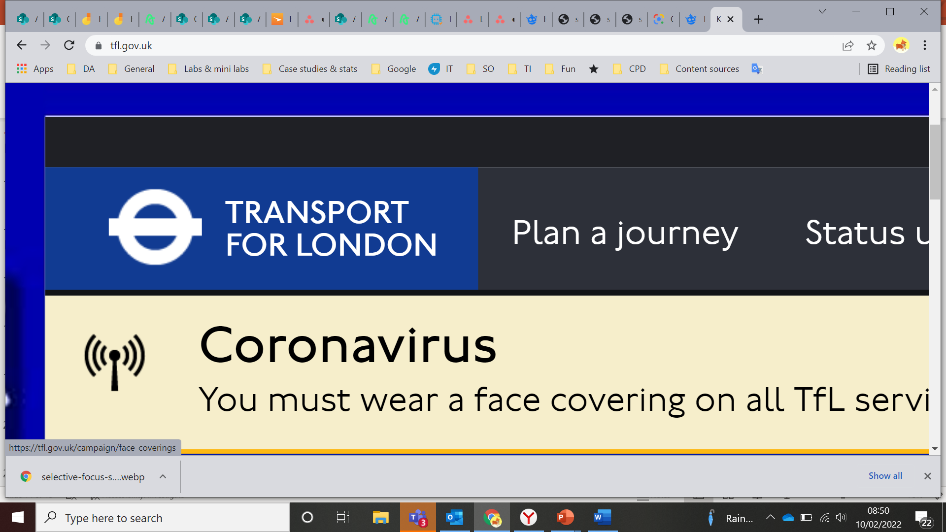

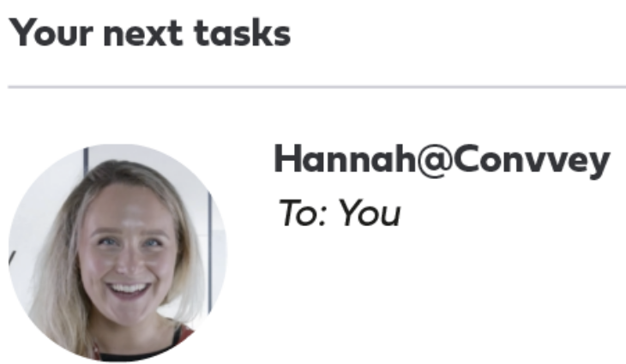


Recap: What's coming up?
Hi there,
I hope you’re having a terrific week. You’ve uncovered some great insights for our clients so far, and we appreciate the time and effort that you’ve given to the projects you’ve worked on.
I have a new fictional client assignment for you this month – Transport for London. TfL wish to improve the overall inventory efficiency for their London cycle hire scheme. They’re implementing a new inventory management process and have recruited the help of Convvey, our fictional data agency.
TfL need to ensure their cycle inventory levels meet customer demand for the coming year. Your task is to answer TfL’s business question:
‘What is the predicted demand for the London cycle hire scheme for the next 12-month period?’
Before you join the team, get a head start by finding out a little more about the TfL’s data. Good luck!
Best, Hannah Bishop Business Insights Manager Convvey Data Insights
Image source: https://tfl.gov.uk/
Notes:
Tutor : Introduce the story for this fusion day.

Slide 16
Task 1
Collaborative discussion
Notes:
9.20

Slide 17

Task 1: Collaborative discussion
10 mins
You’ll join a small group of your fellow analysts in a virtual breakout room to work together to answer the following question:
“
Transport accounts for 23% of the world’s energy-related carbon dioxide (CO2) emissions. What role can data play in reducing this figure?
”
Source: International Institute for Sustainable Development
Notes:
Tutor: Introduce the task and the use of breakout rooms. The question in the speech bubble will appear with a click.
You’ll join a small group of your fellow analysts in a virtual breakout room to work together to answer the following question:
Transport accounts for 23% of the world’s energy-related carbon dioxide (CO2) emissions. What role can data play in reducing this figure?
Refresh on how to have a collaborative discussion
The purpose of the collaborative discussion is to:
Discuss the possible answers to the question posed
Build on each other’s ideas
Emphasise that it's collaborative, not competitive. Be inclusive, integrate points made by others into your contributions, and clarify meaning.
Source:
Mead, L., 2021. The Road to Sustainable Transport. [online] International Institute for Sustainable Development. Available at: <https://www.iisd.org/articles/road-sustainable-transport> [Accessed 10 February 2022].

Slide 18
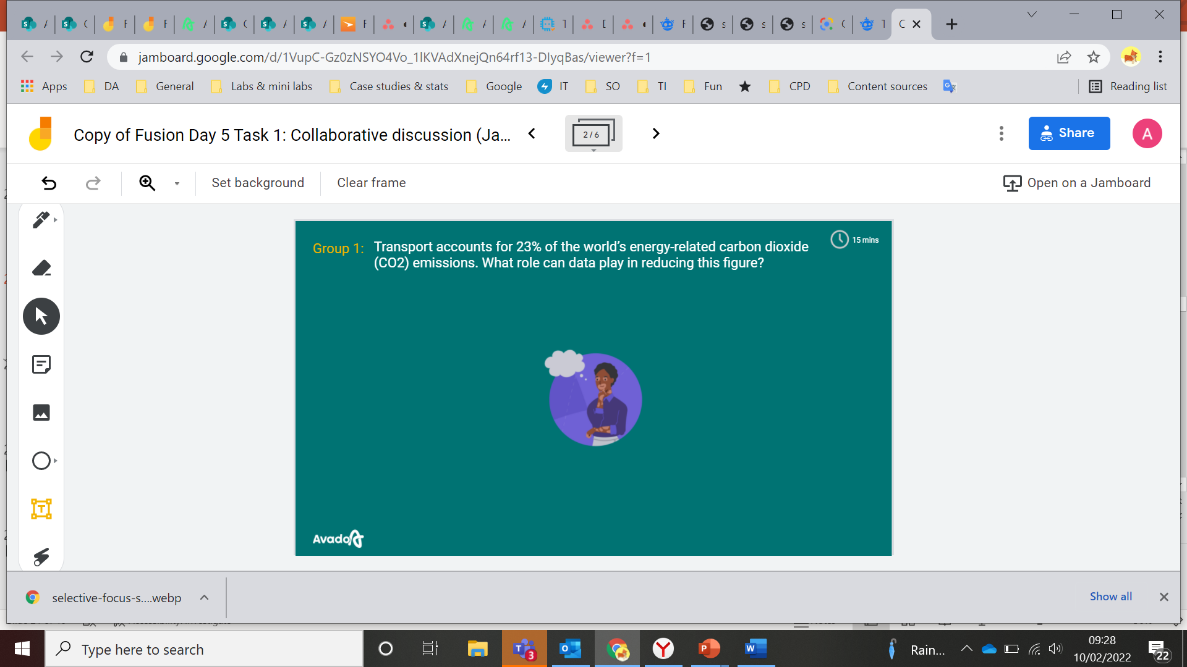
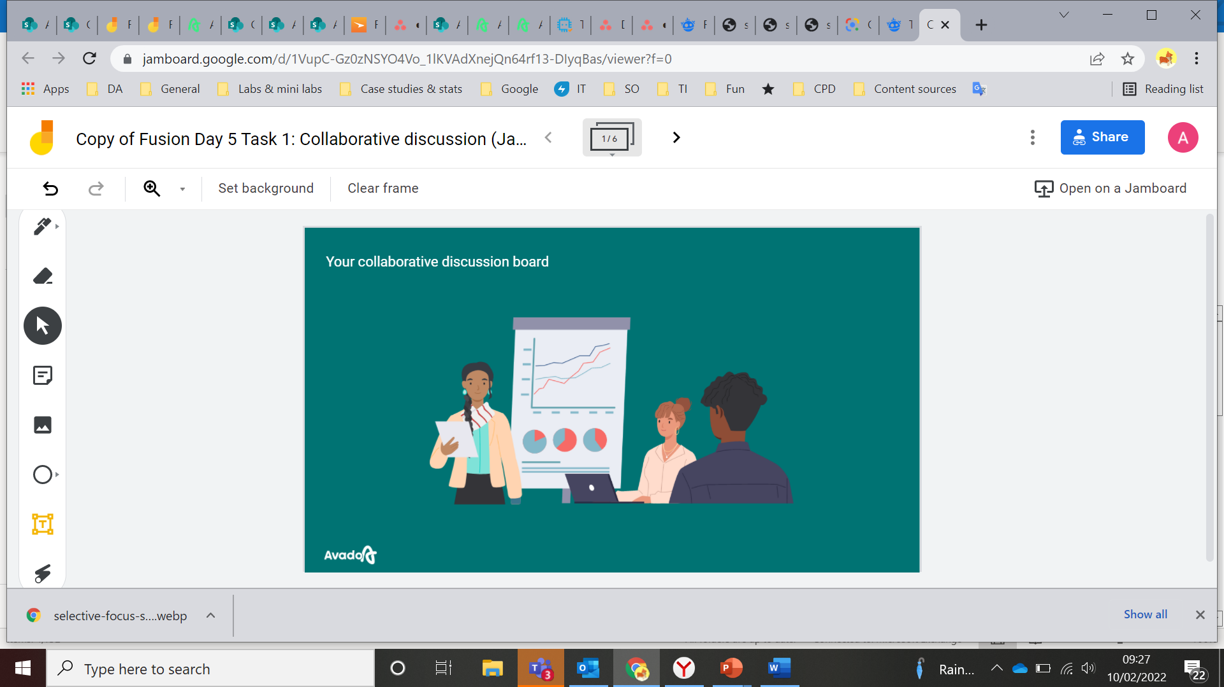
10 mins
Task 1: Collaborative discussion
Instructions:
1.
Join the discussion
2.
Add your thoughts to your group’s Jamboard
3.
Type any discussion notes you’d like to take from this task in the task sheet
Output: Your discussion notes
Notes:
Tutor note: Each point will appear with a click.

Slide 19
Task 1: Breakout room groups
20 mins
Group 1
Group 2
Group 3
Group 4
Group 5
Notes:
Tutor note: Populate each column with the names of participants in each group for breakout rooms. Please remove any columns you don’t need for the session.
Tell the participants they’re about to go into breakout rooms to work in smaller groups to generate ideas for this activity. Ask them to find their name on the list and remember what group number they’re in.

Slide 20

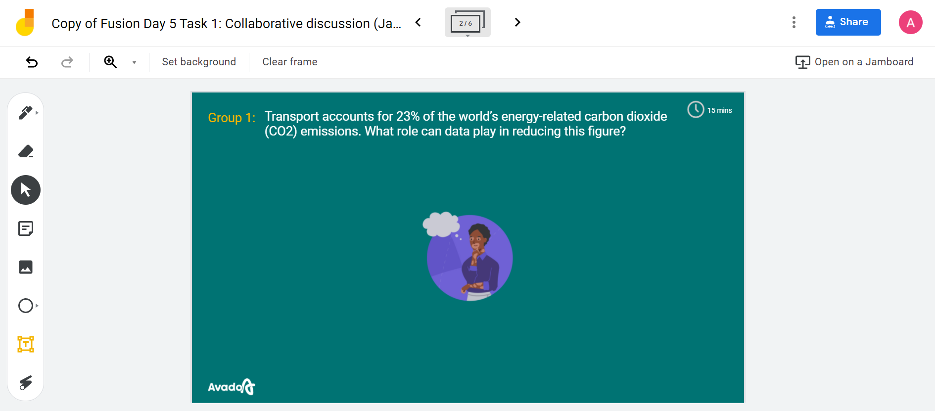
1
Task 1: Jamboard instructions
10 mins
2
3
Notes:
Tutor note: Each numbered arrow will fly in with a click.
Share the link to the Jamboard in the chat AFTER you have explained instructions. (link provided below)
Instructions:
Use the arrows in this area to navigate between slides
Find the frame with your group number
Use sticky notes to add your ideas. You can change the colour and position of your sticky notes. Remember to add your name to each sticky note
Tutor: Start the task by letting learners know that they’re about to go into breakout rooms. Let learners know they have 20 minutes to complete this task.
Facilitator:
Prior to the session, allocate participants to breakout rooms
Post a link to the task Jamboard in the chat: https://jamboard.google.com/d/1VupC-Gz0zNSYO4Vo_1lKVAdXnejQn64rf13-DIyqBas/viewer?f=0
Should another copy of the Jamboard be needed, please use this link: TBC
Put participants into breakout rooms

Slide 21



Task 1: Possible answers
Data can be used to create more efficient transport networks
Data can be collected from in-vehicle assistance systems designed to make driving more fuel efficient
Data can be used to measure the efficiency of self-driving cars. These cars have a range of impacts on energy consumption – both positive and negative
Public transport providers can monitor transport usage, urban mobility data (volume of people moving around a city), and road traffic conditions to ensure supply meets demand
These can include devices that monitor traffic, intelligent deceleration assist, and auto tyre pressure monitoring systems
Source: IFL Science
Notes:
9.35 - 9.50
Task 1 Answers
Source:
IFLScience. n.d. Will Self-Driving Cars Reduce Energy Use And Make Travel Better For The Environment?. [online] Available at: <https://www.iflscience.com/technology/will-self-driving-cars-reduce-energy-use-and-make-travel-better-environment/> [Accessed 10 February 2022].

Slide 22

How useful did you find the task?
1……. 2……. 3……. 4……. 5……. 6……. 7……. 8…….9……. 10
Let me know in the chat

Slide 23

What did you find most useful?
Unmute yourself to share your thoughts

Slide 24

Break
See you soon
Notes:
At tutor's discretion – hide slide if not required
Re start at 10:00
Ten-minute break

Slide 25
While we are waiting for everyone to join…
How much has the search for 'data privacy' increased in the last five years?
a) 30%
b) 88%
c) 164%
d) 202%
Let me know your guess in the chat
Notes:
At tutor's discretion – hide slide if not required
Facilitator: Review answers in the chat and then provide the correct answer.
The correct answer is C) 164%.
“Data privacy” has seen a search growth of 164% over the last five years. People are now searching about their data privacy in greater numbers by the month.
Source:
Exploding Topics. 2021. 7 Key Data Science Trends For 2021-2025 [online] Available at: <https://explodingtopics.com/blog/data-science-trends> [Accessed 7 February 2022].

Slide 26
Agenda
Recap: What are fusion days about?
1
Collaborative discussion
Collaborative work
2
Inventory analysis
Independent work
3
Model predictions
Regather for a team debrief
Notes:
10.00
Tutor note : Share that the numbers here relate to the tasks

Slide 27

You're not alone!
Check-in at key points in Task 2
to talk through your challenges and successes

Slide 28
Task 2 and 3: Answer TfL’s business question
4hrs
“
‘What is the predicted demand for the London cycle hire scheme for the next 12-month period?’
”

Slide 29



Today's resources
Bike_data_2021_part1.xlsx
Bike_data_2021_part2.xlsx
Bike_data_new.xlsx
Task list
Jupyter
notebook
3 Excel files

Slide 30



About TfL dataset
The dataset tracks specific weather conditions that may affect the dependent variable
There are 14 variables included in the datasets; these are listed in your task sheet
The ‘bikecount’ variable is the dependent variable

Slide 31

Tasks 2 and 3: Outputs
Task 2:
A completed Jupyter notebook
Task 3:
A csv file showing the predicted demand for the London cycle hire scheme for the next 12-month period
Notes:
10.05

Slide 32
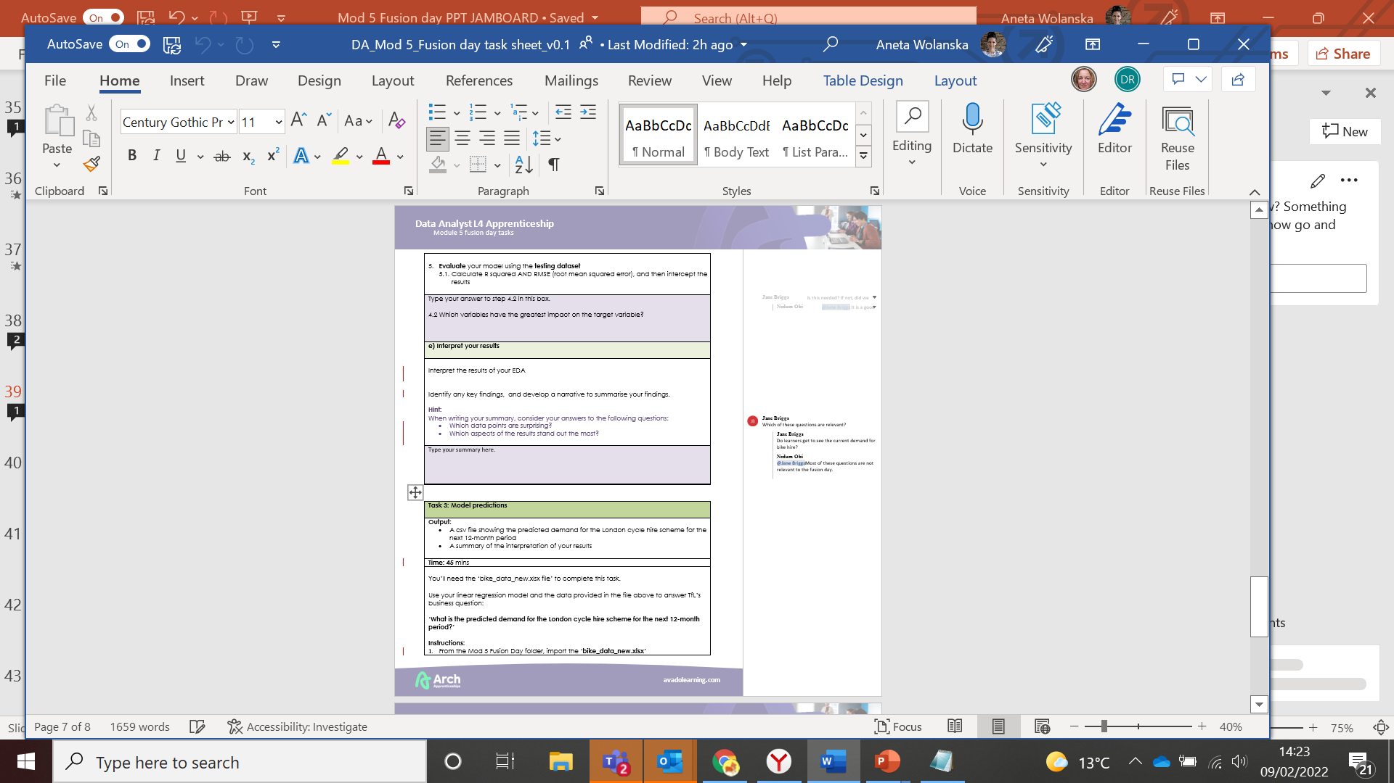
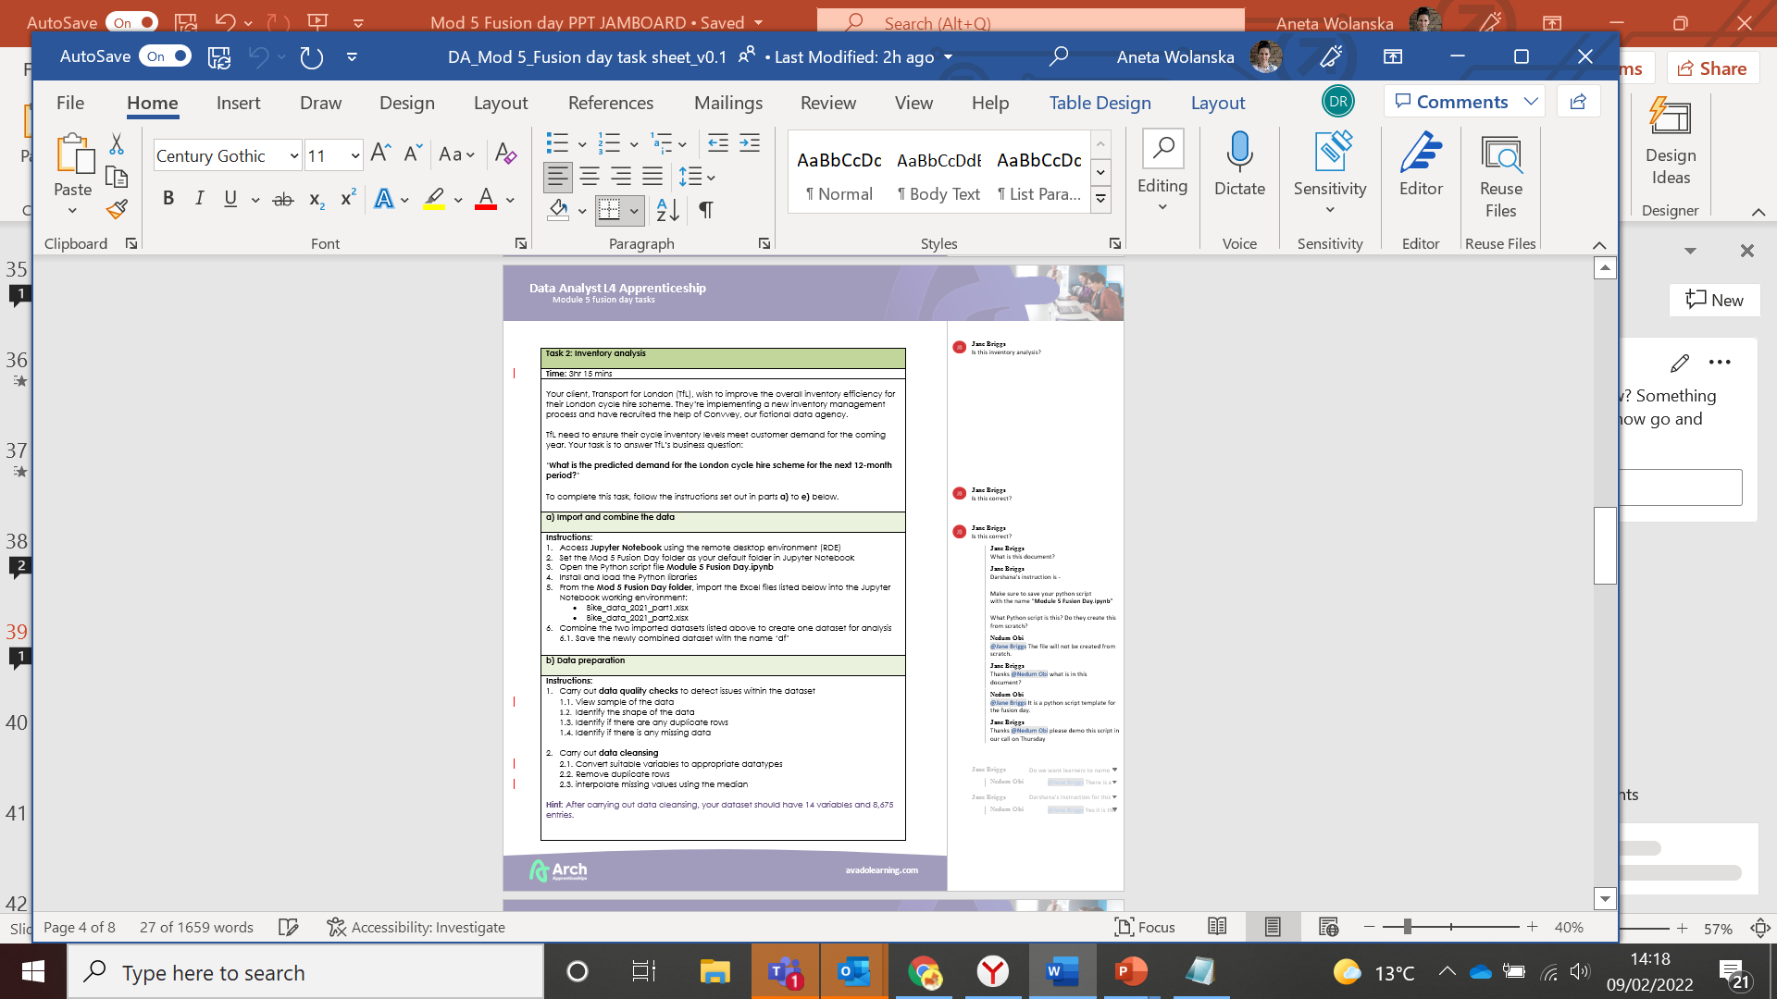

Let's take a look at your resources
Notes:
10.05 - 10.30
Tutor note: Open the task sheet and take the learners through the process of tasks 2 and 3 in detail. Once you’ve finished, ask them if they have any questions.

Slide 33

If you get stuck,
make sure you
reach out to your tutor for help!

Slide 34

Schedule
Task 2 checkpoints (optional)
11:30 – Checkpoint 1
12:45 to 13:30 – Suggested lunch break
13:30 – Checkpoint 2
Team de-brief
16:00 to 16:30
Notes:
10.30
Tutor note: Encourage learners to manage their break time. Suggest 15 mins around 2.45

Slide 35
How useful did you find the tasks?
1……. 2……. 3……. 4……. 5……. 6……. 7……. 8…….9……. 10
Let me know in the chat

Slide 36

What did you find most surprising?
Unmute yourself to share your thoughts
Notes:
Tutor note: Pick a learner who’s rated the activity above 7 and ask for details.

Slide 37



Team debrief
30 mins
Your tutor will share worked examples of the tasks you have completed
You’ll be invited to share what worked well for you and what didn’t work so well
You’ll also discuss what you might do differently next time when faced with a similar task at work
Notes:
Tutor note: The text under each image will appear with a click.

Slide 38
Let’s review example answers
Notes:
Tutor note: Show this slide before sharing worked examples in the analysis tools.
Link to the solution document:

Slide 39
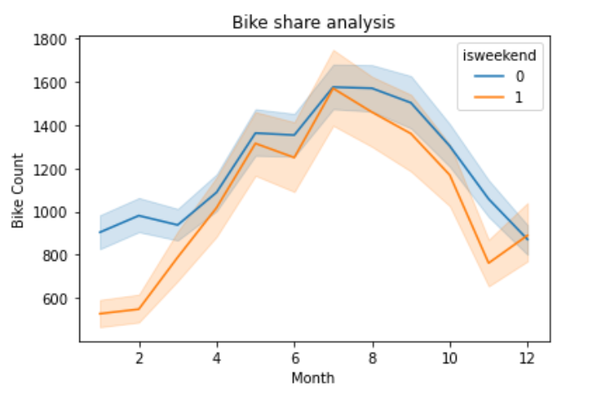
What does the data tell us?

Slide 40
We'd love to get your feedback!
This quick five-minute survey will help us improve on our offerings.
Open the survey link in the chat box to tell us about your experience
Notes:
Tutor note:
Post the link below into the chat box and ask learners to take five minutes to complete the form. Ask learners to use the thumbs up icon to let you know when they’ve completed the form.
Link to feedback form:
https://forms.office.com/Pages/DesignPage.aspx#FormId=nI0fDWumYUG3WxGxnd3cEkx6NRcc1JtAgwxiD9cdWVdUNUNXU0FCUEtHQ0o4MVQ1MldQR0lHM0xVRy4u&Token=28ce5fe7875843e2b9abbf2b1c689b8d

Slide 41
What did you find the most challenging?
Unmute yourself to share your thoughts
Notes:
Tutor note: Pick a learner who’s rated the activity above 7 and ask for details.

Slide 42
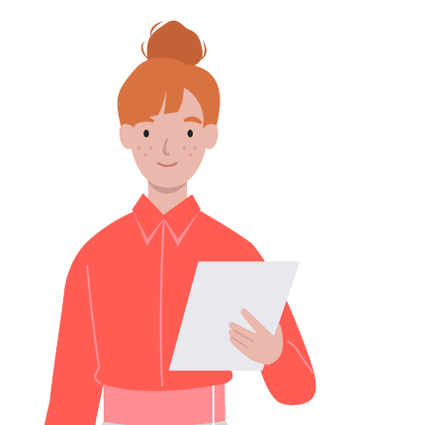
Before you go...
don't forget to download your files from the RDE!
Notes:
Tutors – post the link below into the chat. It's a link to lots of machine learning practice projects using Python.
https://medium.com/coders-camp/230-machine-learning-projects-with-python-5d0c7abf8265

